Slide 1

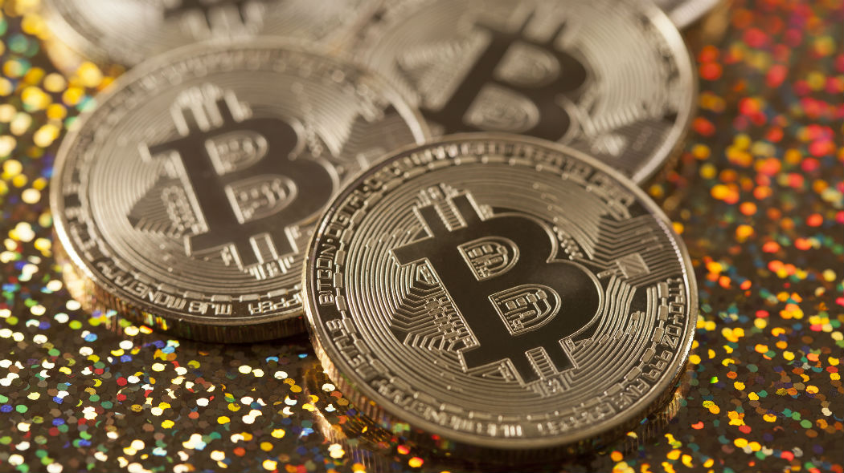
Mini Project: Social Media Impact on Cryptocurrency Prive Movements
By Michael Freda

Slide 2
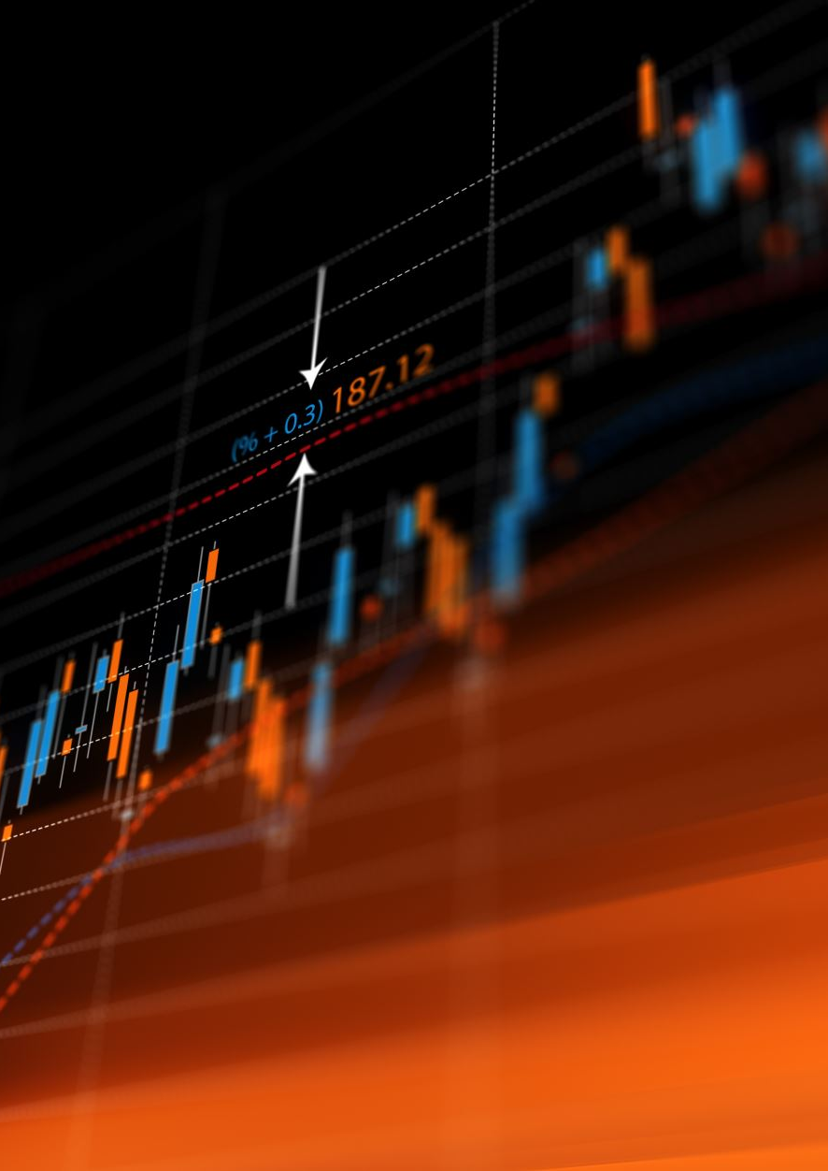
Research Question
My project focuses on the effects of social media when it comes to the cryptocurrency market.
I analyzed historical and real-time cryptocurrency prices and posts & comments on the Bitcoin subreddit to determine if there was a correlation of any sort between the two.
Cryptocurrency Background
Cryptocurrency has been growing over the past decade into a prominent stake of the investment and financial world we live in. As a result, it comes to no surprise that dozens of news outlets and social media icons constantly post about cryptocurrency.
Research Question
Is there a correlation between social media sentiment and cryptocurrency prices? Can we use this potential correlation to predict movements within the cryptocurrency market?

Slide 3
Tractable Data
About this data:
In this project, I utilized data from the CoinGecko API and PRAW (Python Reddit API Wrapper).
CoinGecko API
This API allows for historical and real-time market data for Bitcoin, which was necessary in determining correlation against social media influence.
Some of the fields collected and used in the project were the Bitcoin price valuation and also the timestamp at which the price was recorded at.
PRAW
Allowed scraping of posts and comments from the Bitcoin subreddit to obtain public sentiment.
Some of the fields collected were timestamps for posts and comments, post titles and bodies for sentimental analysis, comment threads, and filter fields such as upvotes, downvotes, and karma scores.

Slide 4
Data Retrieval
Bitcoin Data
It was fairly easy to obtain the necessary data for Bitcoin prices at a given timestamp by using CoinGecko’s API service.
To account for lagging in response-time from posts & comments on Reddit, I collected the Bitcoin price one hour prior and one hour after from the post / comment timestamp, along with the matching timestamp for both.
To prevent rate-limiting problems with the API, I added a minute delay in-between every five requests (API is 5 requests / minute rate-limited).

Slide 5
Data Retrieval (cont’d)
Reddit Data
The data retrieval for Reddit was a bit more painstaking in terms of setting up filters to collect valuable data.
Reddit posts and comments are often flooded with a lot of noise:
Meme posts, spam, low-karma posts, bots, etc.
To account for this, multiple filtering factors were added to help collect useful data. Some of these filters consisted of:
Karma score > 5, post length of at least 3 words, presence of keywords in Crypto (Bitcoin, btc, crypto, blockchain, Ethereum, Litecoin, dogecoin)

Slide 6
Exploratory Data Analysis
Data Preprocessing
To make Bitcoin price data comparable to sentiment scores, I used normalization via min-max scaling, which transforms our price data into a range of 0 to 1, matching our sentiment scores on the same scale.
To account for short-term fluctuations in our data, we utilized Rolling Average (3-period window) (equal weight to each data point within window) and Exponential Smoothing (assigns exponentially decreasing weights to older data points).
Lagged sentiment was utilized to capture the delayed effect of sentiment on Bitcoin prices by shifting the sentiment data by 3 time periods (3 rows in our data frame to reflect 3 timestamps).

Slide 7
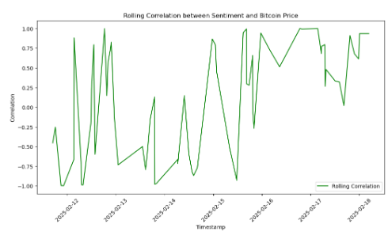
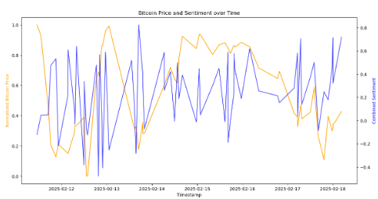
Results
Correlation between Reddit sentiment and Bitcoin price: -0:07

Slide 8
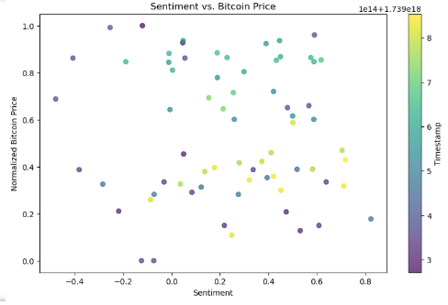
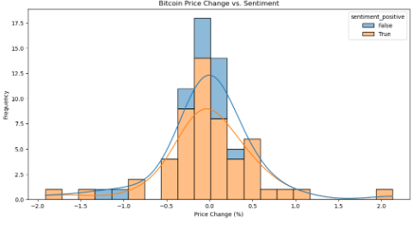
Results (cont’d)

Slide 9
Conclusions
There was no meaningful correlation between social media sentiment and Bitcoin prices discovered through our collected data. With a value of -0.07, our correlation represents a very weak negative correlation, if any.
This does not match what I previously believed, which was that social media sentiment can be utilized to help predict the movement of the cryptocurrency market. This could be due to the selected time range, which may have contributed to high volatility and variability in the data, preventing the identification of a clear and consistent relationship within the data.
Other factors, such as liquidity and market manipulation could have influenced the results as well

Slide 10
Implications For Stakeholders
The results from this project can be used by those interested in the cryptocurrency market to help identify any factors that may be used to construct a more robust model with additional data and factors that may generate better results.
The cryptocurrency market is full of factors outside of sentimental values on social media that may impact the final results, such as the liquidity of the given coin (in this case, Bitcoin), government regulations, blockchain upgrades, security issues, speculation, and market manipulation (whales / large holders of cryptocurrency).
There exists several studies that support the idea of Reddit having an influence on market behavior for cryptocurrency outside of this project. The lack of supporting evidence for this correlation in the project may be due to the low number of data points accounted for, allowing for larger variations in the resulting conclusions, or just the timeframe examined throughout the project.

Slide 11
Ethical, Legal, Societal Implications
The data used in this project is collected ethically by following proper API policies and preventing potential biases in the sentiment analysis models utilized for the overall results.
The results of this project highlight the potential ethical concerns regarding market manipulation, despite the little to no correlation between social media and cryptocurrency prices. It is important for social media users to stay aware of market manipulation and misinformation being conducted by individuals or groups to influence public opinion and sway market prices.
The social media data and public sentiment analysis adheres to privacy and data protection regulations as no identifiers are present in the project, resulting in anonymized data.
It is important to pay close attention to all information regarding a cryptocurrency and making an independent decision. Herd mentality is often present within these social media discussions, leading to decisions driven by fear and greed in these discussions.

Slide 12
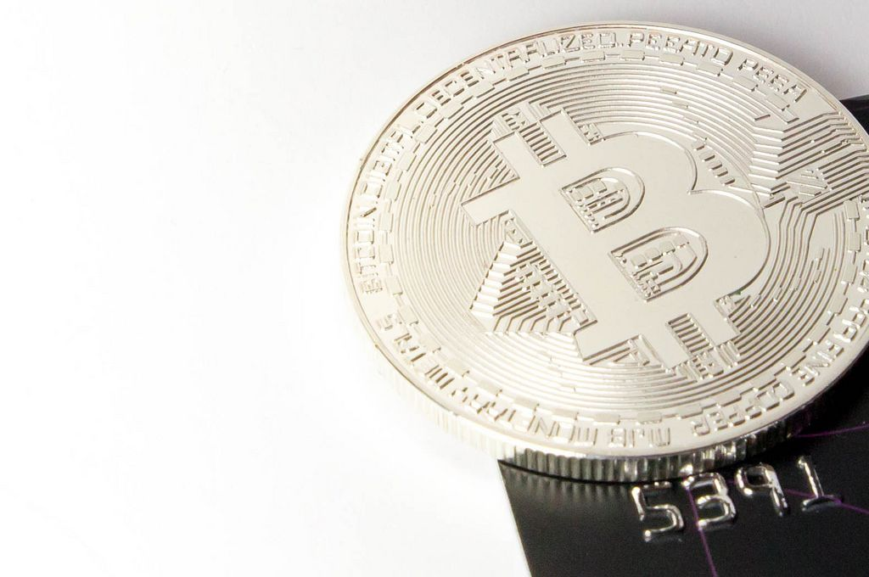
Thank you!

